Slide 1
Introduction to the QUDT Ontology
Quantities, Units, Dimensions and Types
April 28, 2020

Slide 2
Why have a units ontology?
Provides a formal way of specifying units explicitly, thereby avoiding tacit conventions that are prone to misinterpretation.
QUDT distinguishes between variants of a given unit.
unit:BTU_IT
British Thermal Unit (BTU or Btu) is a traditional unit of energy equal to about 1.0550558526 kilojoule.
unit:BTU_TH
British Thermal Unit (thermochemical definition, BTUth) is a traditional unit of energy equal to about 1.0543502645 kilojoule. It is approximately the amount of energy needed to heat 1 pound (0.454 kg) of water from 39∘F to 40∘F

Slide 3
Why have a units ontology?
QUDT distinguishes between units of different types that are commonly referred to with the same name.
Second - unit:SEC (the unit of time)
Second - unit:ARCSEC (the unit of plane angle)
The ontology provides explicit conversion information
Built-in conversion factors support mathematical operations combining different (commensurate) units
The data carries its metadata along with it, so unit conversion errors are avoided

Slide 4
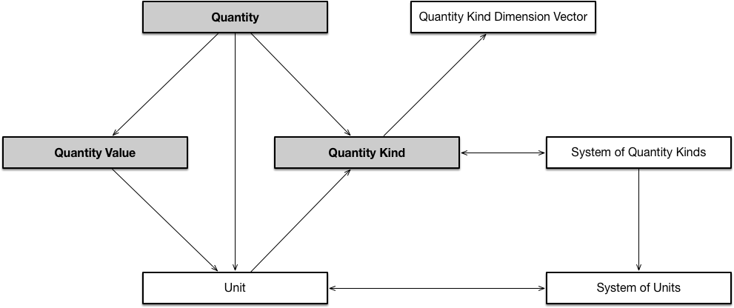
The core design pattern

Slide 5
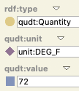
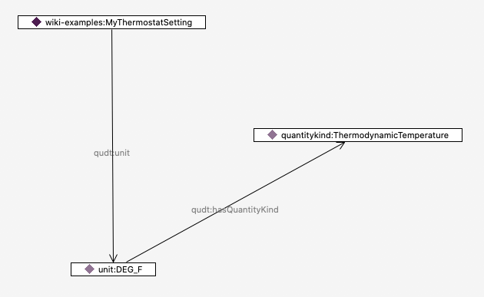
A simple example
Quantity
QuantityKind
wiki-examples:MyThermostatSetting
rdf:type qudt:Quantity ;
qudt:unit unit:DEG_F ;
qudt:value "72" .
Unit

Slide 6
A simple example
Quantity
Your application
QUDT
QuantityKind
wiki-examples:MyThermostatSetting
rdf:type qudt:Quantity ;
qudt:unit unit:DEG_F ;
qudt:value "72" .
Unit

Slide 7
Deeper structure in QUDT
All QuantityKinds are defined in terms of dimension vectors
E.g. the 7 base units of S.I. correspond to the 7 base dimension vectors
Length - meter (m)
Time - second (s)
Amount of substance - mole (mole)
Electric current - ampere (A)
Temperature - kelvin (K)
Luminous intensity - candela (cd)
Mass - kilogram (kg)
This allows automated
Unit conversion
Dimensional analysis
Identification/validation checking for commensurate units

Slide 8
Automated generation of unit conversions
PREFIX qudt: http://qudt.org/schema/qudt/
PREFIX rdfs: http://www.w3.org/2000/01/rdf-schema#
PREFIX smf: http://topbraid.org/sparqlmotionfunctions#
PREFIX fn: http://www.w3.org/2005/xpath-functions#
SELECT DISTINCT ?toConvert ?label ?into ?otherUnitLabel ?multiplyBy ?multiplier
WHERE {
BIND ("To convert" AS ?toConvert) .
BIND ("into" AS ?into) .
BIND ("multiply by" AS ?multiplyBy) .
?unit a qudt:Unit .
?unit rdfs:label ?label .
FILTER (fn:contains (smf:lowerCase(?label), "milligray")) .
?unit qudt:conversionMultiplier ?cm1 .
?unit qudt:hasQuantityKind/qudt:hasDimensionVector ?qkdv .
?otherUnit qudt:hasQuantityKind/qudt:hasDimensionVector ?qkdv .
?otherUnit a qudt:Unit .
FILTER (?otherUnit != ?unit) .
?otherUnit qudt:conversionMultiplier ?cm2 .
?otherUnit rdfs:label ?otherUnitLabel .
BIND ((?cm1/?cm2) AS ?multiplier) .
}
ORDER BY ?label ?multiplier
This SPARQL query finds all units commensurate with the MilliGRAY, and calculates the conversion factor
To convert MilliGRAY into Kilocalorie per Gram multiply by 2.390057361376673E-10
To convert MilliGRAY into MegaJ PER KiloGM multiply by 1.0E-9
To convert MilliGRAY into CAL_IT PER GM multiply by 2.388458966274959E-7
To convert MilliGRAY into calorieIT per gram (calIT/g) multiply by 2.388458966274959E-7
To convert MilliGRAY into CAL_TH PER GM multiply by 2.390057361376673E-7
To convert MilliGRAY into calorieTH per gram (calTH/g) multiply by 2.390057361376673E-7
To convert MilliGRAY into BTU-IT-PER-lb multiply by 4.299226139294927E-7
To convert MilliGRAY into British Thermal Unit (TH) Per Pound multiply by 4.30210433032265E-7
To convert MilliGRAY into J PER GM multiply by 1.0E-6
To convert MilliGRAY into BTU_IT PER LB_F multiply by 4.216100966554345E-6
To convert MilliGRAY into Gray multiply by 0.001e0
To convert MilliGRAY into Joule per Kilogram multiply by 0.001e0
To convert MilliGRAY into Sievert multiply by 0.001e0
To convert MilliGRAY into Rad multiply by 0.1e0
To convert MilliGRAY into Rem multiply by 0.1e0
To convert MilliGRAY into MilliSV multiply by 1.0e0
To convert MilliGRAY into ERG PER GM multiply by 10.0e0
To convert MilliGRAY into Erg per Gram multiply by 10.0e0
To convert MilliGRAY into MilliR equivalent man multiply by 3875.968992248062e0
To convert MilliGRAY into MilliR multiply by 3875.968992248062e0

Slide 9
QUDT statistics
At last count there are:
Number of units: 1522
There are 746 quantitykinds
There are 148 dimension vectors
QUDT includes entries/cross references to units and codes from:
S.I. (BIPM/NIST)
ISO/IEC 80000
IEC 61360
UCUM
UN/ECE
BACnet (in progress)

Slide 10
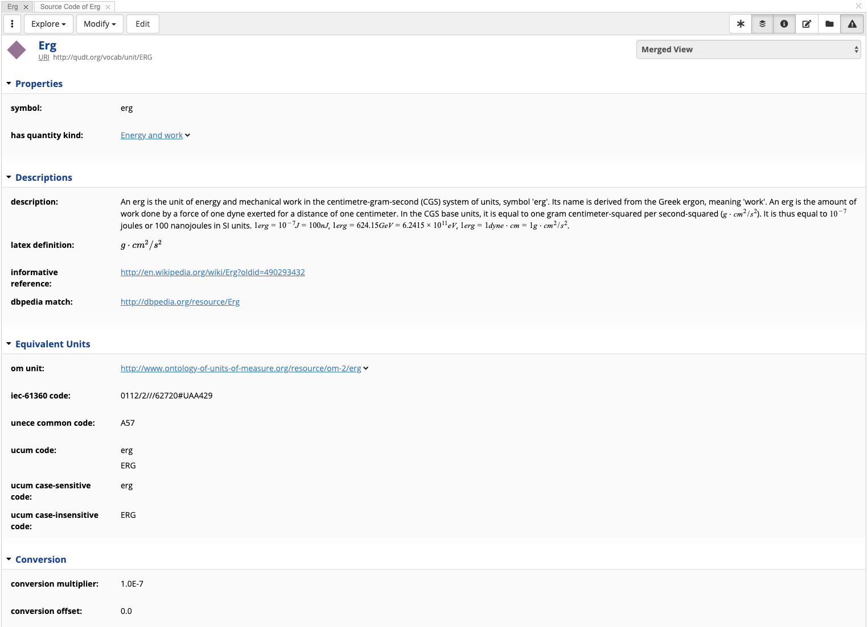

Slide 11
Useful links
http://qudt.org – Homepage
https://github.com/qudt/qudt-public-repo – Github repository
https://github.com/qudt/qudt-public-repo/wiki/User-Guide-for-QUDT – User Guide (in progress)
There is much more to the model, including support for other systems of units, dimensionless units, complex datatypes, treatment of non-linear units and scales…
As an open source project, we are always looking for participants to help error-check, add new units, provide domain expertise

